Slide 1
Model name The Community Land Model version 5 (CLM5) Land component of CESM2 and NorESM2-LM in C4MIP

Slide 2
Lead PI or contact person and her/his affiliation.
C4MIP – CESM2 National Center for Atmospheric Research (NCAR) Keith Lindsay klindsay@ucar.edu
C4MIP – NorESM2-LM Norwegian Climate Centre (NCC) Jerry Tjiputra, Jörg Schwinger jerry.tjiputra@norceresearch.no, jorg.schwinger@norceresearch.no
TRENDY – CLM5.0 National Center for Atmospheric Research (NCAR) CLM4.5(BGC) Danica Lombardozzi, dll@ucar.edu

Slide 3
Static or dynamic vegetation C4MIP: static TRENDY: static
Number of plant functional types C4MIP: 22
TRENDY: max 22
What disturbances are simulated (e.g., land use or fire etc.)? C4MIP: Fire and prescribed LULCC TRENDY: Land use for S3

Slide 4
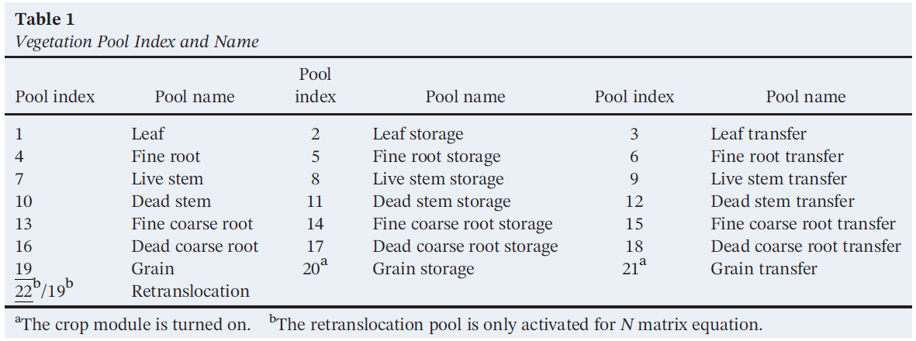
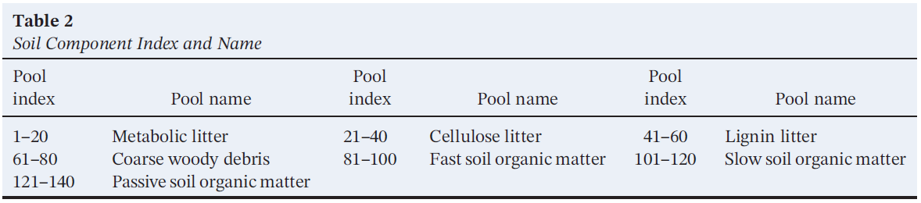
6. Number of pools

Slide 5
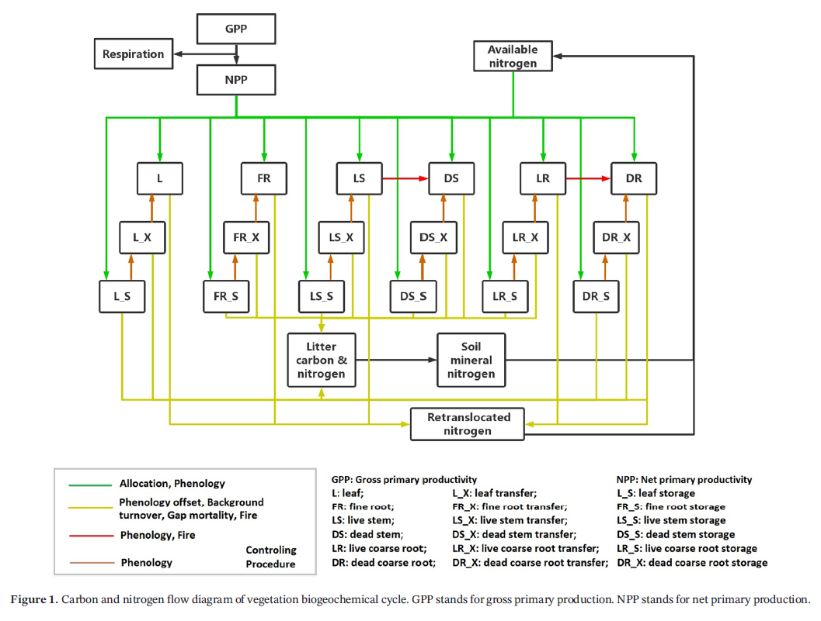
7. How are pools connected? (i.e., carbon flow diagram)

Slide 6
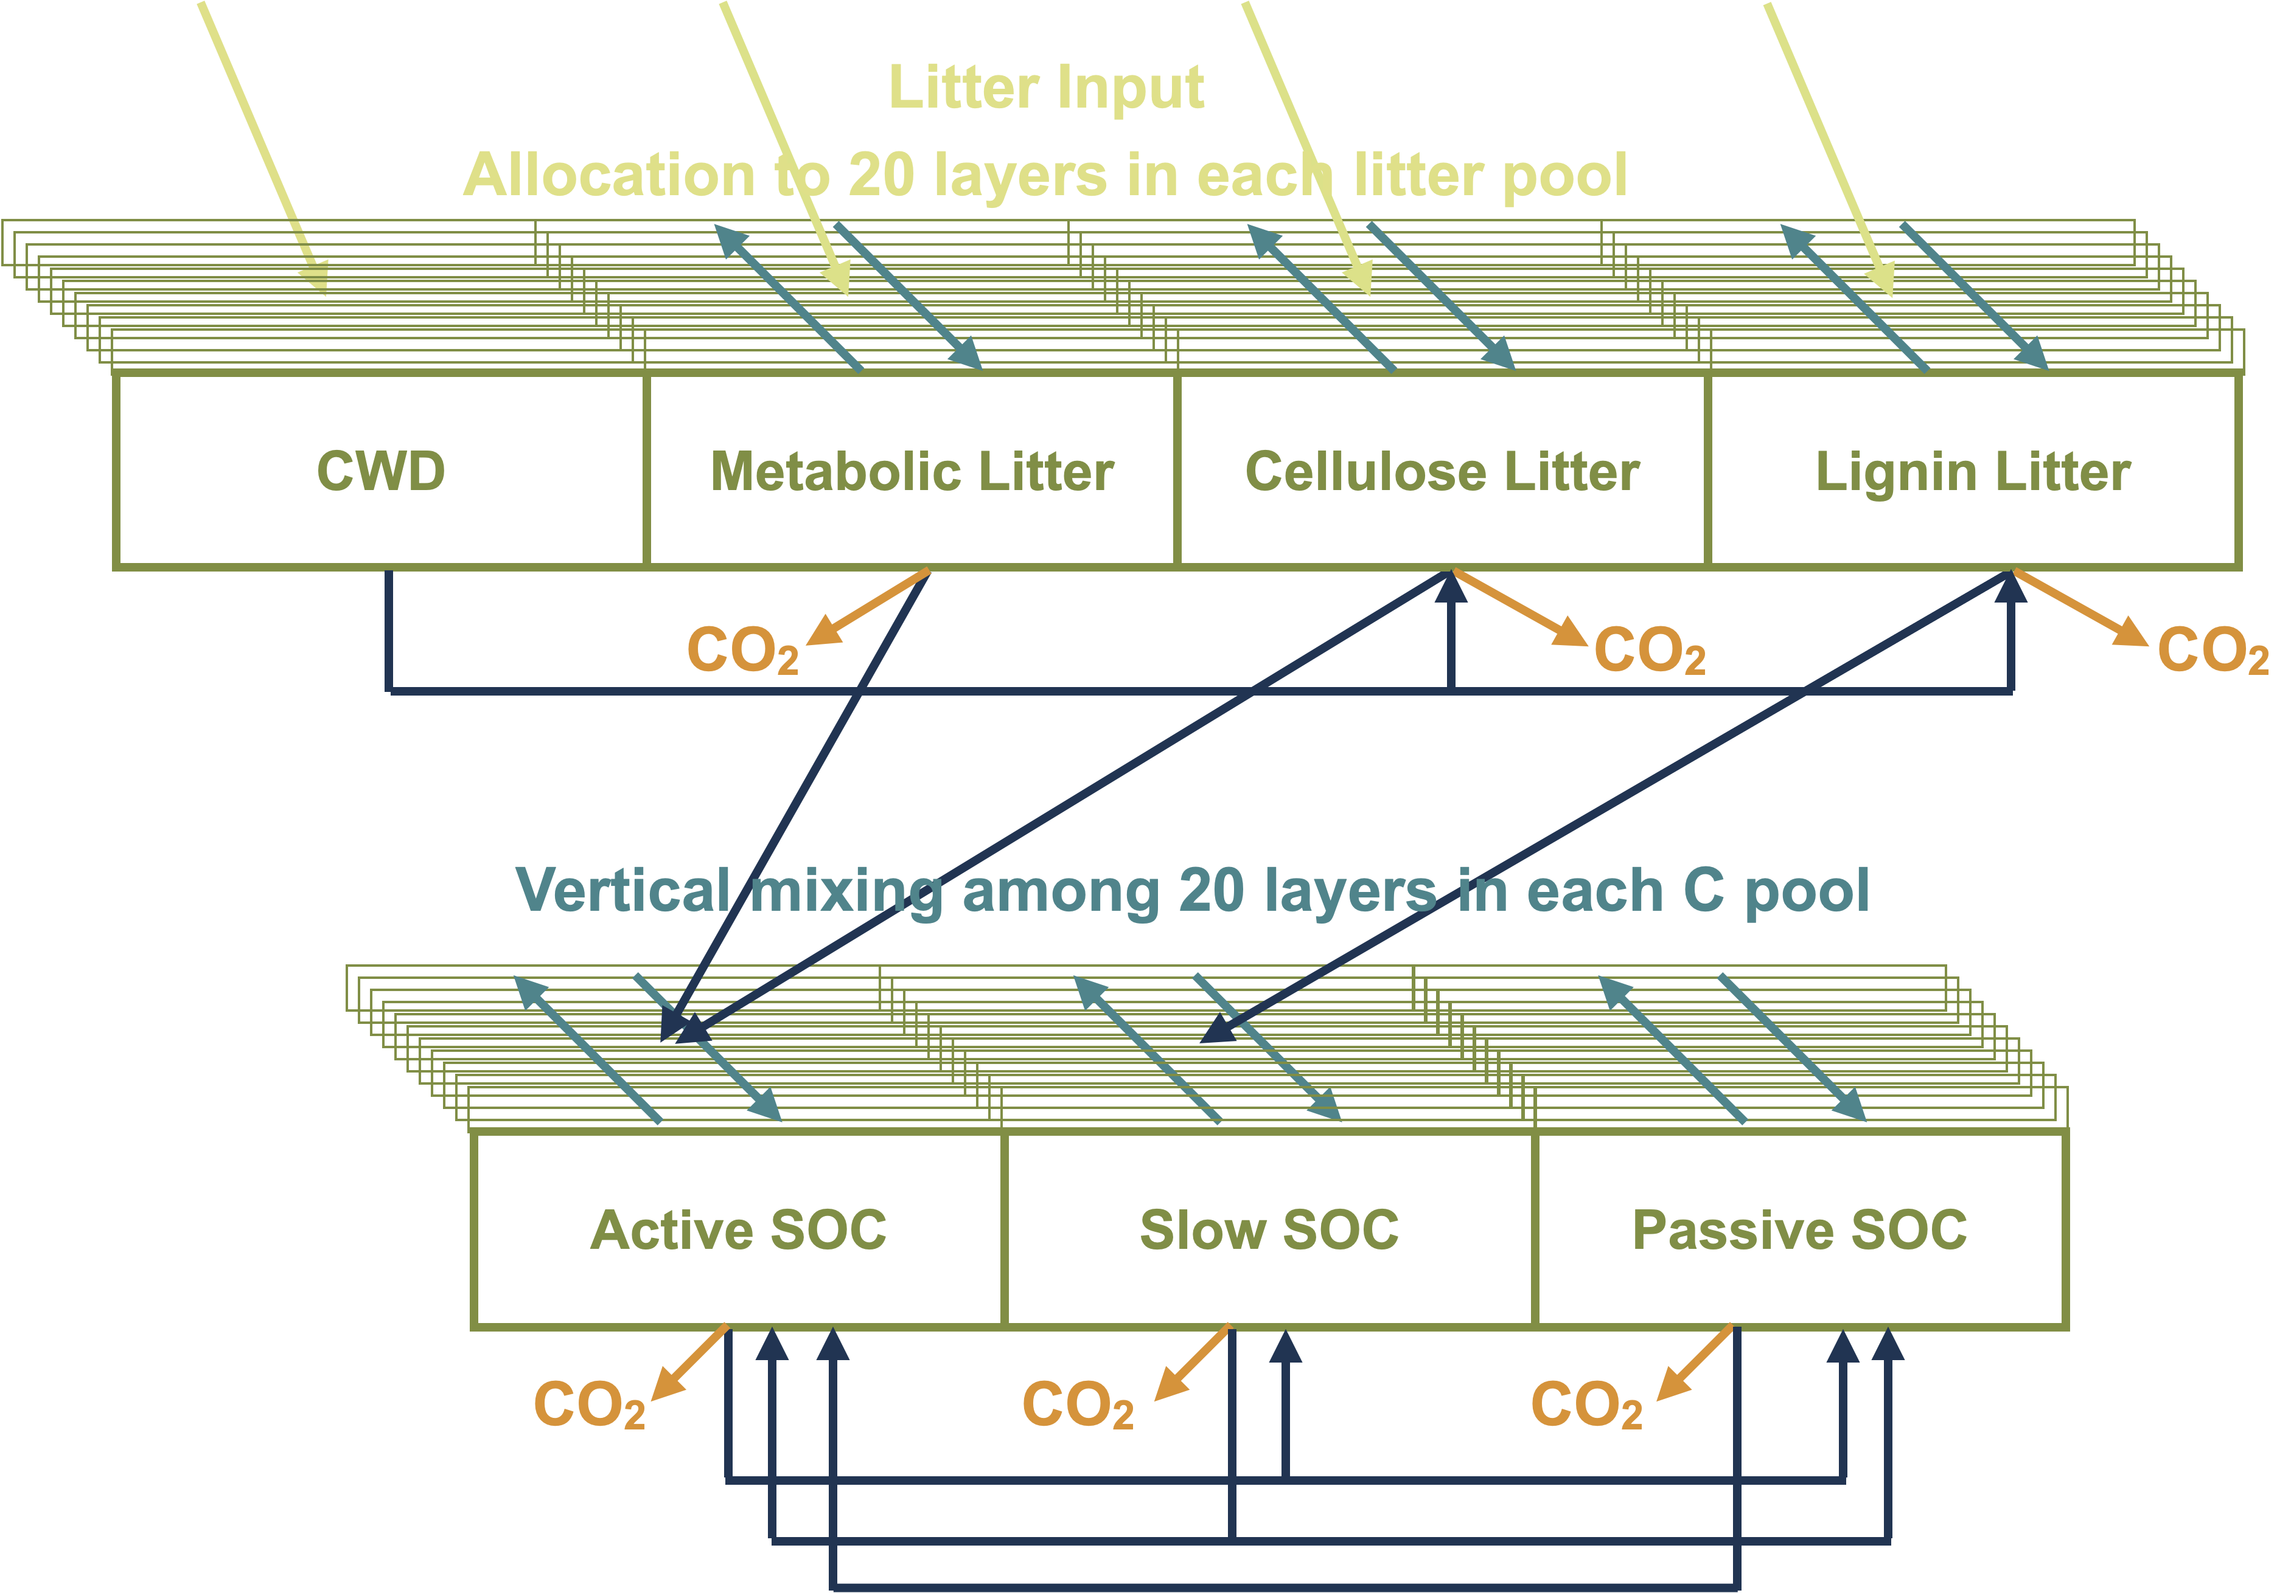
7. How are pools connected? (i.e., carbon flow diagram)

Slide 7
8. Outputs for CMIP6 or TRENDY
TRENDY output:
http://dgvm.ceh.ac.uk/files/Trendy_ListofVariables_Nov2011.pdf
CMIP6 output:
https://esgf-node.ipsl.upmc.fr/search/cmip6-ipsl/

